Slide 1
CS677 Final Project - All Pair Shortest Path
May.1.2019
By. Yiding Yang

Slide 2
1, APSP Revisited
-What's the problem and why is it important
Aiming to determinate the shortest distances between every pair of vertices in a directed graph
The result in the form of matrix called distance matrix
What we can do with the distance matrix:
Get the shortest path from every pair of vertices
Base problem for many other problems

Slide 3
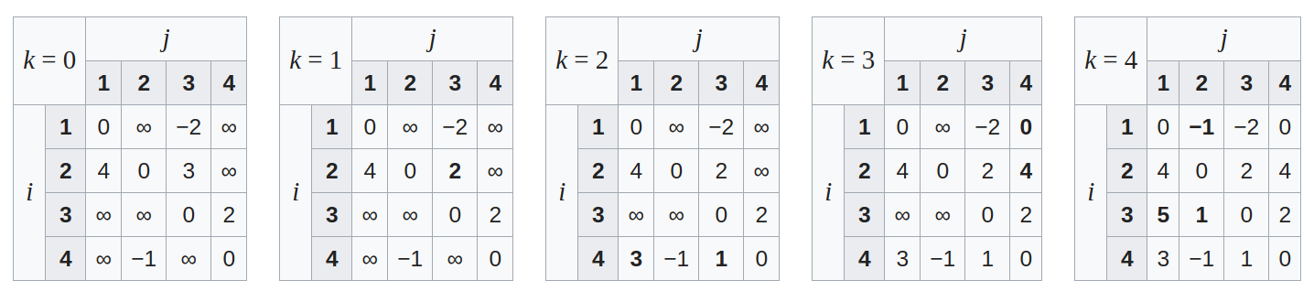
2, CPU implementation
Floyd-Warshall algorithm
an iteration algorithm over k(number of vertices)
relax the shortest distance for every pair of vertices by insert a new vertice
three for loops which runs in O(N^3) time
*picture from wikipedia

Slide 4
3, Why is GPU suited to APSP
In place computation
potential low memory bandwidth
Almost 100% computing
An recursive algorithm which makes the compute for each pair independent
assign each pair of vertices to one thread without communication

Slide 5
4, Experiments setup
Graph generation
random graph generate using Erdos-Renyi model
average degree is 6.5
number of vertices from 100 to 20000

Slide 6
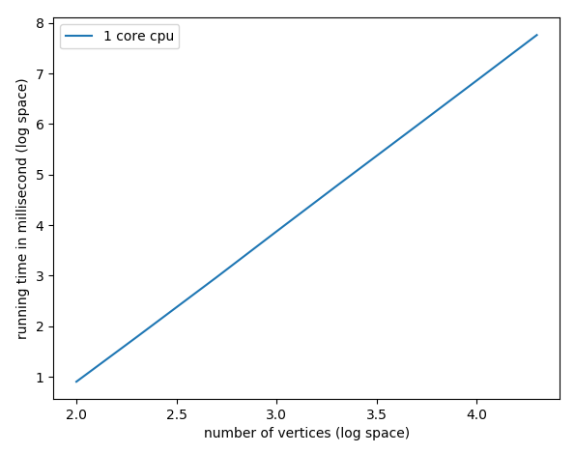
5, CPU Performance
CPU version
exact linear curve when we set the x and y-axes in log space

Slide 7
6, GPU implementation
Iteration version which is same as CPU
GPU version floyd-warshall
Recursive version which make it more suitable for GPU
R-keene algorithm
Some improvement versions based on R-keene

Slide 8
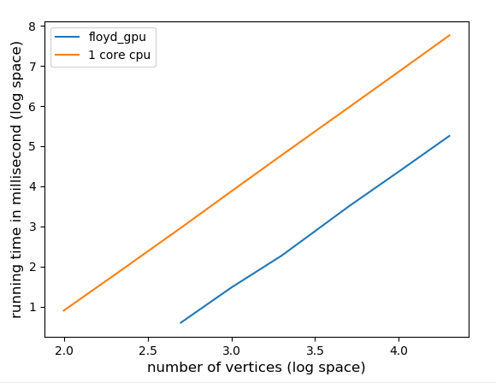
6, GPU implementation
version 1: GPU version of Floyd-warshall with global memory
For each k, call GPU kernel
each thread calculate one pair of vertices by relaxing the shortest path for all other vertices
The GPU kernel will be called #vertices times
use shared memory next?
Problem: Each thread needs to access one row and one col of the whole matrix to get the result which make it hard to use shared memory
319x

Slide 9
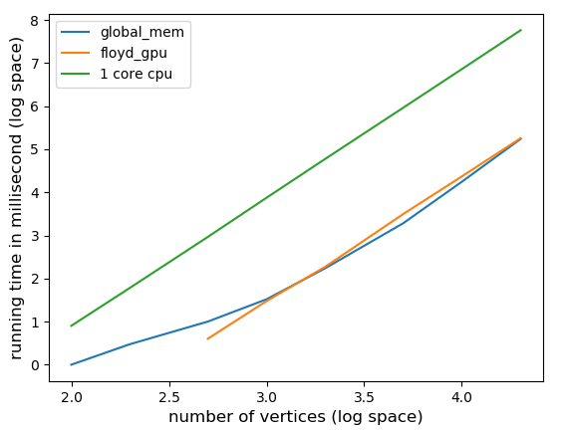
6, GPU implementation
version 2: Recursive with global memory
Recursive R-keene algorithm is more friendly for GPU
1x

Slide 10
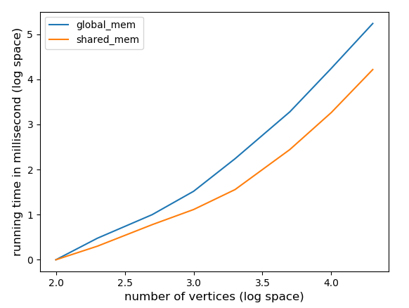
6, GPU implementation
version 3: Recursive with shared memory
10.5x

Slide 11
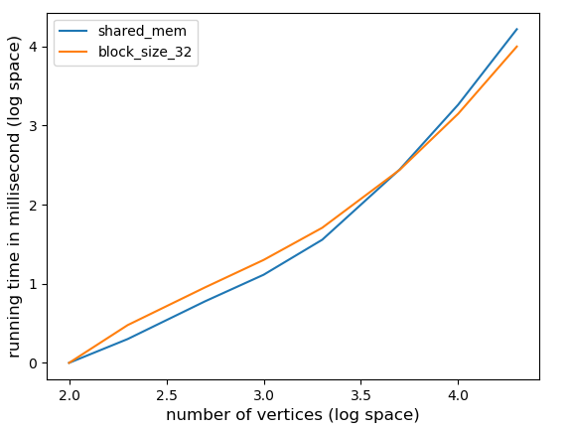
6, GPU implementation
version 4: Recursive with shared memory
- with larger blocksize (32)
1.65x

Slide 12
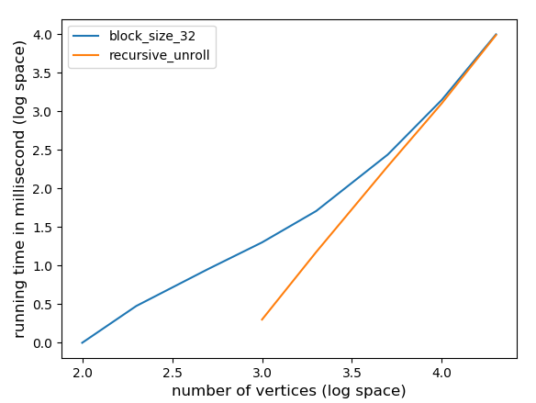
6, GPU implementation
version 5: Unroll the recursive
Get almost linear curve in log space

Slide 13
6, GPU implementation
version with global memory
Used 32 registers, 385 bytes cmem[0], 4 bytes cmem[2]
version with shared memory
Used 27 registers, 2048 bytes smem, 385 bytes cmem[0]
version with shared memory
-threads per block increace to 32
Used 28 registers, 8192 bytes smem, 385 bytes cmem[0]
version with shared memory and recursive unroll
-threads per block increace to 32
Used 28 registers, 8192 bytes smem, 385 bytes cmem[0]
Used 12 registers, 4096 bytes smem, 344 bytes cmem[0]
all of these version have a 100% occupancy

Slide 14
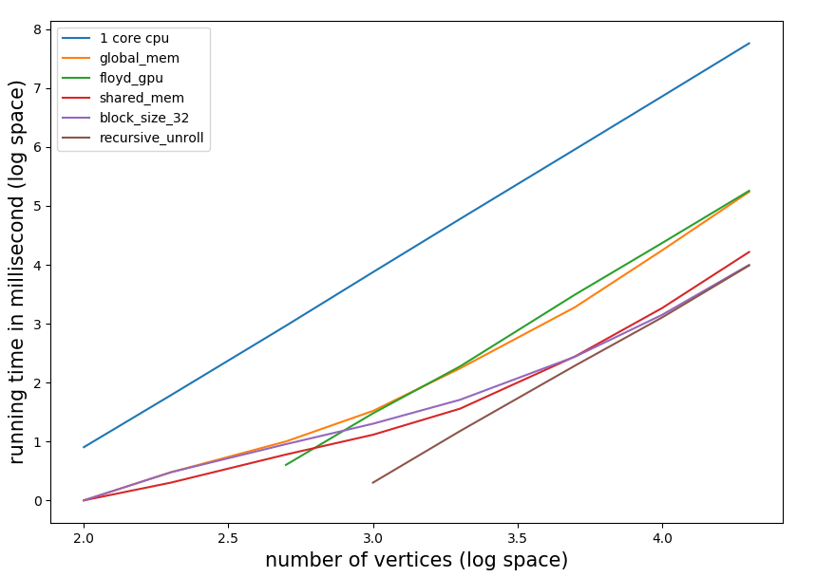
7, A big picture
16 hours can now reduce to only 10 seconds

